Slide 1
Information Architecture
in web development

Slide 2
Information Architecture
“Information architecture is the science of figuring out what you want your site to do and then constructing a blueprint before you dive in and put the thing together.” Information Architecture Tutorial, Retrieved September 25, 2010 from http://www.webmonkey.com/2010/02/information_architecture_tutorial/

Slide 3
An Analogy...
What do you do when you write a paper??
How do you begin?
How do you structure what you’re going to write about?
How do you approach writing a piece of investigative journalism or scientific research?
How do you write a book?

Slide 4
Information Architect?
From a Paypal job description, Summer 2010:
“Do you have a knack for recognizing patterns? Do you have a love of language and data? Do you often ponder what makes people do the things they do?”
Job description includes:
Document site maps, navigation models, content models
Understanding target audiences' needs, tasks, and goals and translating them into easily discoverable elements
Translate business requirements into meaningful [user] experiences
Leading and/or participating in immersive user research, concept testing, usability testing, and analytics Information Architect Job Posting for Paypal. Retrieved September 25, 2010 from http://iainstitute.org/jobboard/jobs/job.php?id=5677

Slide 5
IA Questions
Ask a lot of questions:
Why are you creating this site or application?
Who is the audience?
What is the content?
How will it be maintained?
What are the goals or expected outcomes?
Now is also a good time to ask about the site’s “personality”
In the simplest terms, we ask these questions extensively, gather up the results, and then create our ‘blueprint’.

Slide 6
IA Blueprint
May consist of some or all of:
A hand drawn sketch
A bulleted list (typed)
A skeleton layout showing primary content blocks, menu blocks, and persistent links
An interface mockup built in a graphics tool or in the browser (html)
A site or application “wireframe” for helping clients focus on content and/or application design

Slide 7
Some Pointers
Keep it simple.
Look at or be aware of competitors – what are they doing? Can you do it better?
Isn’t this just common sense?
Treat ‘power’ with respect, but don’t overvalue power’s opinion.
Avoid kitchen sinking.

Slide 8
Examples?

Slide 9
Bulleted List (you all know this!)
Section 1
Subsection 1.A
Subsection 1.B
Subsection 1.C
Section 2
Subsection 2.A
Subsection 2.B
Subsection 2.B.i
Subsection 2.B.ii

Slide 10
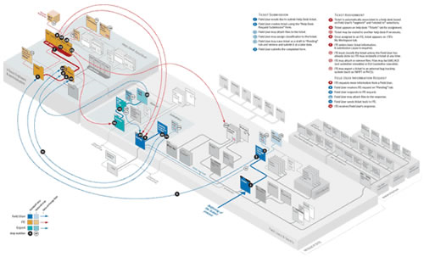
Site Diagram
Should AJAX Wireframes be Different? [Bitmap]. Retrieved September 25, 2010 from http://dd.dynamicdiagrams.com/category/information-architecture/

Slide 11
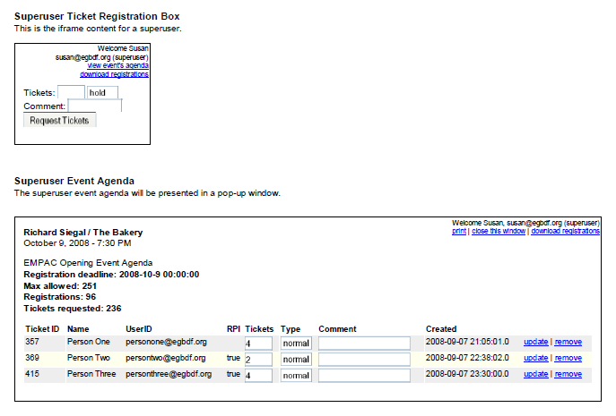
Interface Mock-Up
Schwartz, Gary and Arlen Johnson. Bedework and Large Venue Ticketing. Retrieved September 25, 2010 from http://www.bedework.org/downloads/webcontent/papers/BedeworkEMPAC.pdf

Slide 12
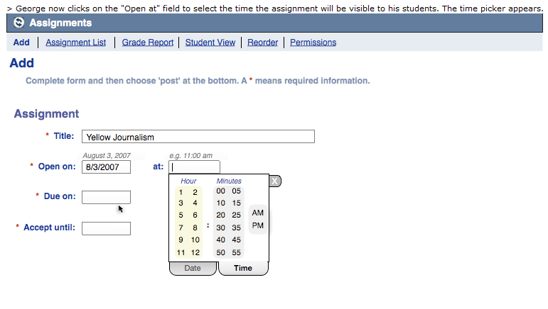
Storyboard
Bloodworth, Allison. Date Time Picker Storyboard – Selecting Opening Date and Time - Tabbed. Retrieved September 25, 2010 from http://wiki.fluidproject.org/display/fluid/Date+Time+Picker+Storyboard+-+Selecting+Opening+Date+and+Time+-+Tabbed+Timepicker

Slide 13


Lab 3 Example?
iit
index.html
projects.html
resources
Lab3.css
someImage.jpg

Slide 14
Lab 3 Example?
iit
index.html
lab3
resources
lab2.css
projects.html
lab3.css
someimage.png
lab2
resume.html

